Slide 1
Regression Discontinuity and Interrupted Time Series Designs
Lab 6

Slide 2
Context for Regression Discontinuity Design
Some (observed) continuous variable is associated with treatment assignment, such that individuals below a certain cutoff receive one treatment and individuals above cutoff receive different treatment
Medication based on observed cholesterol / blood pressure / CD4 levels
School interventions for kids who score below certain level on standardized tests

Slide 3
Fundamental Assumptions
Strict assignment discontinuity at the cutpoint. If not, may have selection bias
Model of relationship between assignment and outcome model is correctly specified
Sufficient sample size
All individuals (who end up in tx and control groups) must be drawn from the same population
Treatment level and duration is equivalent for all individuals in the treatment group (only one version of the treatment)

Slide 4
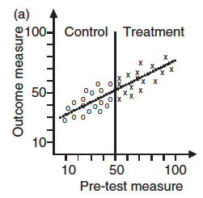
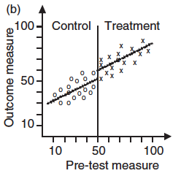
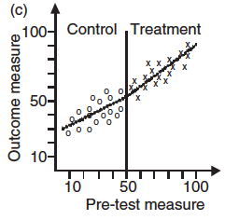
Visualizing discontinuity
(a) No treatment effect: linear relationship between X and Y
(b) Classic discontinuity = treatment effect
(c) No treatment effect: curvilinear relationship between X and Y

Slide 5
Regression Discontinuity Models
Fundamental regression discontinuity model (Troachim 1984, Shadish et al, 2002):
Y = β₀ + β₁*Tx + β₂*(X – Xc)
where X is the continuous variable that is associated with treatment assignment
Centering X ensures that estimates of the treatment effect are made at the cut-off point instead of a 0
Could expand model so that both slope and intercept are allowed to vary after discontinuity
Y = β₀ + β₁*Tx + β₂*(X – Xc) + β₄*Tx*(X-Xc)

Slide 6
RD Scatterplot: Positive Treatment Effect

Slide 7
RD Scatterplot: No Treatment Effect

Slide 8
Visualizing Potential Outcomes

Slide 9
Nonlinearity Mistaken for Discontinuity
Notes:
Mis –specifiying the functional form (ie. The association between the assignment variable and the outcome) is the single biggest threat to internal validity in an RD desging.

Slide 10
Polynomial Regression
Notes:
Regression that distinguishes the nonlinear and discontinuous jump from the smooth linear function.

Slide 11
Local Linear Regression
Notes:
Instead of locally fitting a constant function(e.g.,the mean),fit linear regressions to observations within some bandwidth of the cutoff
– A rectangular kernel seems to work best (see Imbens and Lemieux), but optimal bandwidth selection is an open question
– But, really ,we’re just talking about running regressions on data near the cutoff.

Slide 12
Interrupted Time Series Designs

Slide 13
What is ITS?
A series of observations on the same dependent variable over time
Interrupted time series is a special type of time series where treatment/intervention occurred at a specific point and the series is broken up by the introduction of the intervention.
If the treatment has a causal impact, the post-intervention series will have a different level or slope than the pre-intervention series

Slide 14
The effect can be a change in intercept

Slide 15
The effects of charging for directory assistance in Cincinnati
Intervention

Slide 16
The effect can be a change in slope

Slide 17
Canada Sexual Assault Law Reform

Slide 18
Ramsay et al, 2003

Slide 19
The Model
Use segmented regression analysis (Wagner et al, 2002):
Ŷ_{t} = β₀ + β₁ x time_{t} + β₂ x intervention_{t} + β₃ x time_after_intervention_{t} + e_{t}
Y_{t} is the outcome
Time a continious variable beginning at the start of the series until the end of observation
intervention is a dummy variable taking the values 0 in the pre-intervention segment and 1 in the post-intervention segment
time_after_intervention is 0 in the pre-intervention segment and counts time in the post-intervention segment at time t
β₀ estimates the base level of the outcome at the beginning of the series
β₁ estimates the base trend, i.e. the change in outcome in the pre-intervention segment
β₂ estimates the change in level in the post-intervention segment
β₃ estimates the change in trend in the post-intervention segment
e_{t} estimates the error

Slide 20
Threats to Validity
Forces other than the intervention under investigation influenced the dependent variable
Could add a no-treatment time series from a control group
Instrumentation – how was data collected/recorded
Selection – did the composition of the experimental group change at the time of intervention?
Poorly specified intervention point; diffusion
Choice of outcome – usually have only routinely collected data
Power, violated test assumptions, unreliability of measurements, reactivity etc.

Slide 21
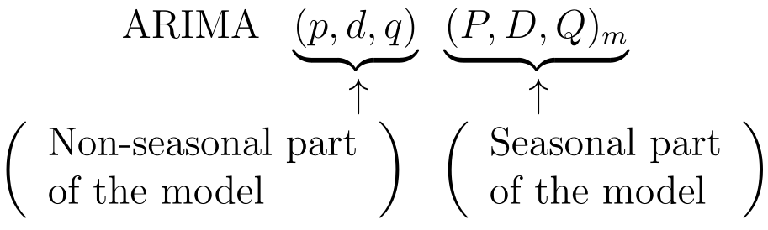
ARIMA (Auto-regressive integrated moving average)
(Non-seasonal) ARIMA(p,d,q) model
p = order of the autoregressive part
d = degree of first differencing involved;
q =order of the moving average part
Seasonal ARIMA models

Slide 22

The ARIMA Model
The explanatory variables are time-lagged values of the variable y.
The ARIMA model models the single dependent variable (Y) as a function of past values of Y as well as past values of the error terms (e).

Slide 23
Identifying the ARIMA Model
Main identification tool → Autocorrelations
MODEL | ACF | PACF
AR(1) | Exponential decay | Spike at lag 1, then 0
AR(p) | Exponential decay or damped sine wave. | Spikes at lags 1 to p, then zero
MA(1) | Spike at lag 1, then 0 | Exponential decay
MA(q) | Spikes at lags 1 to q, then zero | Exponential decay or damped sine wave.

Slide 24
Unique Features of Time Series Data
Non-stationarity | There is a ‘natural’ trend in the data (e.g. upward sloping), independent from other events.
Auto-correlation | Values at one point in time are statistically correlated with past values of the data. Adjacent data points in time are more likely to be close to each other than points that are further from each other First-order correlation—a point at a date t is correlated with the point at date t-1 . Another form of correlation might be linked to seasonality: the level of an outcome over a particular season might be correlated to the level over the same season the year before.
Seasonality | There are some regular (expected) changes in the outcome due to seasonal effects (e.g. increase in utilization due to the seasonality of some diseases).

Slide 25
ARIMA modeling for ITS
Specify the best and most parsimonious ARIMA model fitting the outcome series y_{t} before the intervention
Model the entire dataset (pre- and post-intervention) augmented by the interruption component
Abrupt and permanent change modeled with a step function
Abrupt and temporary change modeled by a pulse function

